Slide 1
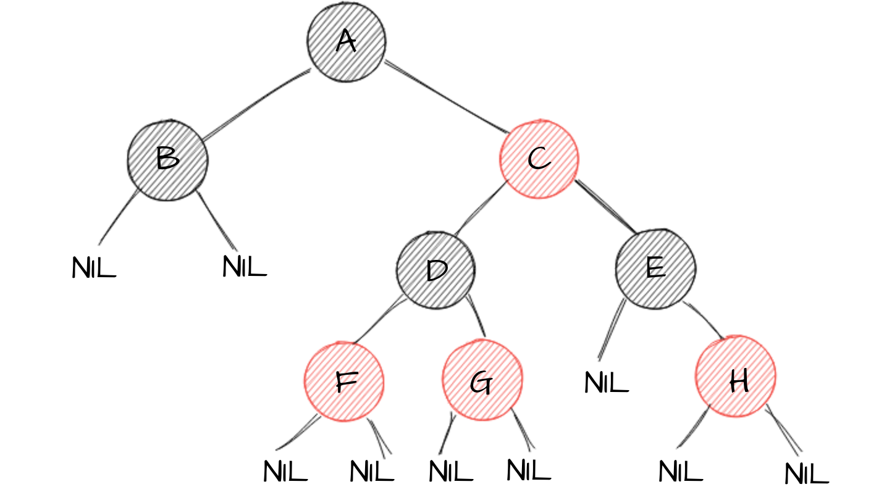
RED BLACK TREES
Anant Thazhemadam
Arjun Menon

Slide 2
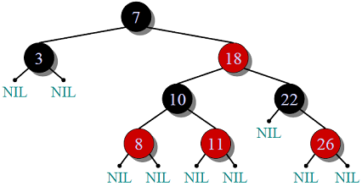
Introduction
Red-Black Tree is a self-balancing Binary Search Tree (BST) where every node follows following rules.
1) Every node has a color either red or black.
2) Root of tree is always black.
3) A new node is always red.
4) There are no two adjacent red nodes.
(A red node cannot have a red parent or red child).
5) Every path from a node (including root) to any of its descendant NULL node
has the same number of black nodes.
6) Every NULL node is considered to be black.

Slide 3
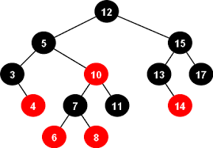
Why Red-Black Trees?
Most of the BST operations take O(h) time where h is the height of the BST.
The cost of these operations may become O(n) for a skewed Binary tree.
If we make sure that height of the tree remains O(logn) after every insertion and deletion, then we can guarantee an upper bound of O(Logn) for all these operations.

Slide 4
Why Red-Black Trees?
AVL Trees also take O(logN) time complexity, generally speaking.
However, Red Black Trees provide the added benefit of easier balancing and rebalancing for inputs, since it is not necessarily always height-balanced in nature, and doesn’t always require rotations.
Note: This can also be interpreted as Red Black Trees may be AVL Trees too, but aren’t always AVL Trees.

Slide 5

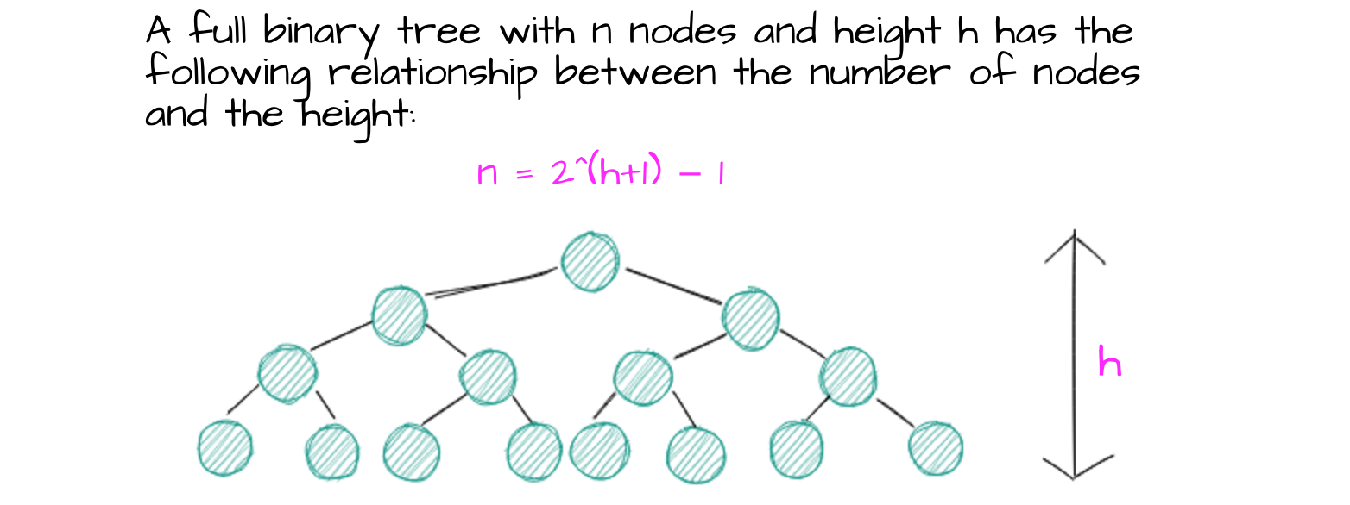

Slide 6
ADT Representation - Nodes
Red Black Trees can be represented using nodes that have the following characteristics :
enum COLOR //Color for each node. Color can be represented using a character as well.
{Red, Black};
typedef struct tree_node //Node in RBT.
{ int data;
struct tree_node *right; //Left Child Pointer.
struct tree_node *left; //Right Child Pointer.
struct tree_node *parent; //Parent Pointer.
enum COLOR color; //Color.
} tree_node;
typedef struct red_black_tree //Red Black Tree.
{ tree_node *root; //ROOT Node.
tree_node *NIL; //NIL (NULL) nodes for newly inserted nodes.
} red_black_tree;

Slide 7
ADT Representation – Operations/Functions
Red Black Trees have the following basic operations performed on them :
Insertion
After Insertion, color-based rule sorting is performed.
Deletion
After Insertion, color-based rule sorting is performed.
Traversal
Inorder
Postorder
Preorder

Slide 8
Functions implemented
tree_node *minimum(red_black_tree *t, tree_node *x); //Minimum node
- returns the minimum node in the subtree with x as the root node.
tree_node *new_tree_node(int data); //Initialize new node.
- initializes a new tree node, with color = Red, user specified data and NULL links.
red_black_tree *new_red_black_tree(); //Initialize new Red-Black Tree.
- initializes a new tree itself
void left_rotate(red_black_tree *t, tree_node *x); //Left side rotation operations
- left_rotate is utilized for all rotations that are to be done, when an operation is performed on a left child.
void right_rotate(red_black_tree *t, tree_node *x);//Right side rotation operations
- right_rotate is utilized for all rotations that are to be done, when an operation is performed on a right child.
void insertion_fixup(red_black_tree *t, tree_node *z); //Fixing color integrity w.r.t rules
- rb_insertion_fixup is used to fix the color integrity of the tree, after a deletion takes place.
void insert(red_black_tree *t, int val); //Insertion into RBT
- insert is called to insert a node into the tree, with a value that doesn’t already exist in the tree.

Slide 9
Functions implemented
void rb_transplant(red_black_tree *t, tree_node *u, tree_node *v); //Transplanting node after operation
- rb_transplant is used to transplant node v, and its respective subtree(s) to the position of node u
void rb_delete_fixup(red_black_tree *t, tree_node *x); //Fixing color integrity w.r.t rules
- rb_delete_fixup is used to fix the color integrity of the tree, after a deletion takes place.
void rb_delete(red_black_tree *t, tree_node *z); //Actual deletion takes place
- rb_delete has the node that is to be deleted passed to it. Deletion of node takes place; and node links are restructured.
void delete (red_black_tree *t, int val); //Delete a node
- delete is called to delete a node; if present in the tree.
int search(red_black_tree *t, int val); //Presence of element in a tree.
- returns 0 if element is absent in tree, 1 if element is present in tree.
void inorder(red_black_tree *t, tree_node *n); //Inorder Traversal
void postorder(red_black_tree *t, tree_node *n); //Postorder Traversal
void preorder(red_black_tree *t, tree_node *n); //Preorder Traversal

Slide 10
Insertion into a Red Black Tree
In Red-Black Trees, for balancing is performed whilst insertion.
The first step in insertion is inserting an element like in the ordinary BST.
As per rules, this node is marked Red.
The first node that is entered into the tree will be marked as the ROOT node, and made Black.
Next, we check for violations. (The most obvious violation is of the rule that a red node mustn’t have red children.)
In case a violation is present, we try to balance the tree, using recolouring or by perform rotations.

Slide 11
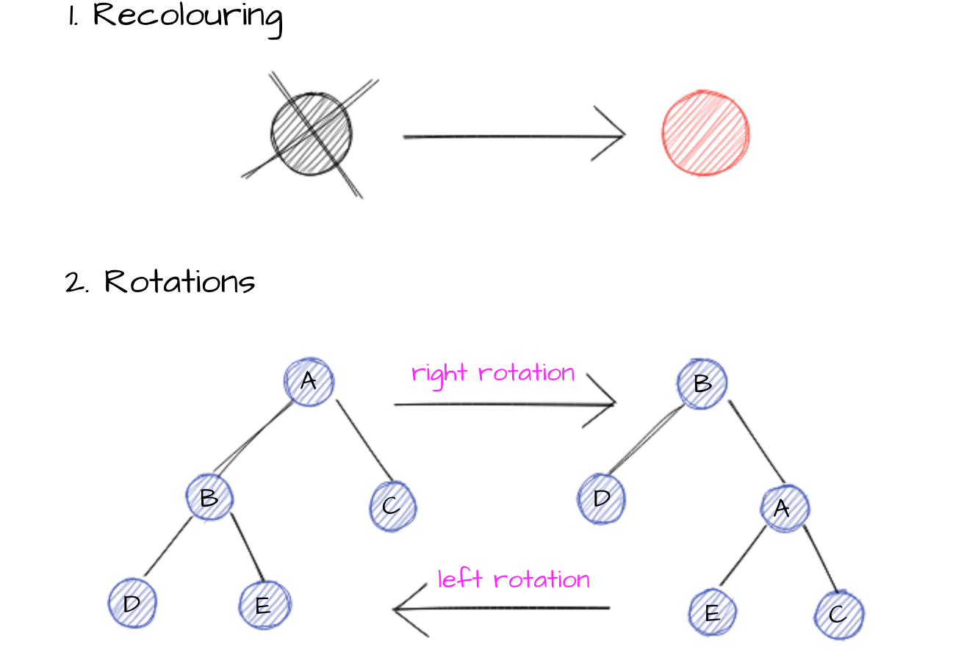
Insertion into a Red Black Tree
To balance the tree, the new node’s “uncle” is considered. The uncle is the sibling of the parent node of the new node.
If the Uncle is a Red node, then Recolouring is performed.
If the Uncle is a Black node, then Rotation is performed. There are 4 cases for Rotation.

Slide 12
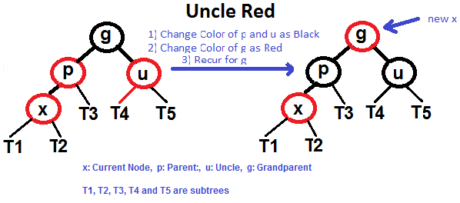
Insertion - Recolouring
The parent and uncle nodes are first made black nodes.
The grandparent node is made Red node. This ensures there are equal number of Black nodes down every possible path in the tree.
If the grandparent node is the root node, then the grandparent node is made a Black Node.

Slide 13
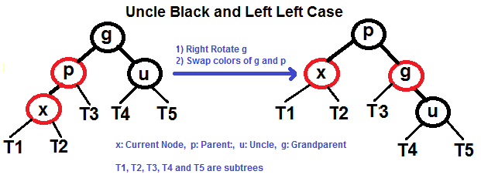
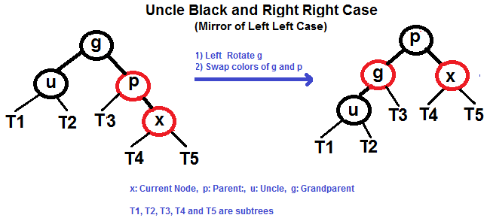
Insertion - Rotations
Left-Left Rotations.
Right-Right Rotations.

Slide 14
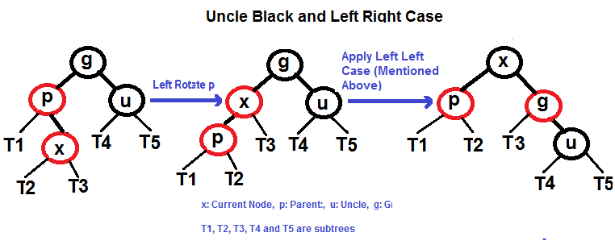
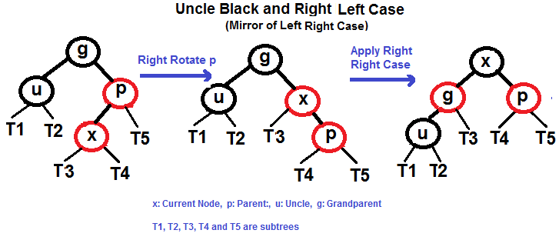
Insertion - Rotations
Left-Right Rotations.
Right-Left Rotations.

Slide 15
Deletion from a Red Black Tree
Both recolouring and rotation operations are used to maintain integrity of the RBT after deletion. In insertion, we check the color of uncle to maintain balance. In deletion, we check the color of the sibling.
The main property that violates after insertion is two consecutive red nodes. In deletion, the main violated property is, change of black height in subtrees; as deletion of a black node may cause reduced black height in one root to leaf path. Note: For a tree of height h, black height = h/2.
When a black node is deleted and replaced by a black child, the child is marked as double black. The main task now becomes to convert this double black to single black.

Slide 16
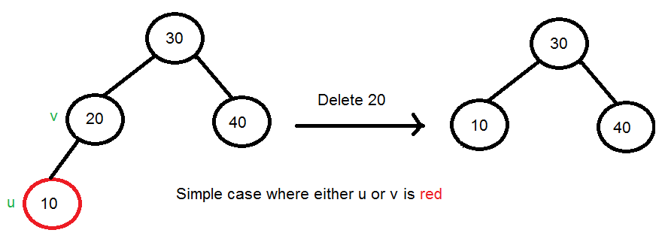
Deletion from a Red Black Tree
Consider c to be the child node of the node to be deleted, and x to be its parent node.
Use the standard BST deletion procedure.
For leaf nodes, delete node directly.
For nodes with only one child, delete node, and attach child to the parent node.
For internal nodes, delete and replace with the inorder successor (typically inorder successor is used over inorder predecessor).2.
Either c or x are black:
Mark the replaced child as black. This observes no change in black height.

Slide 17
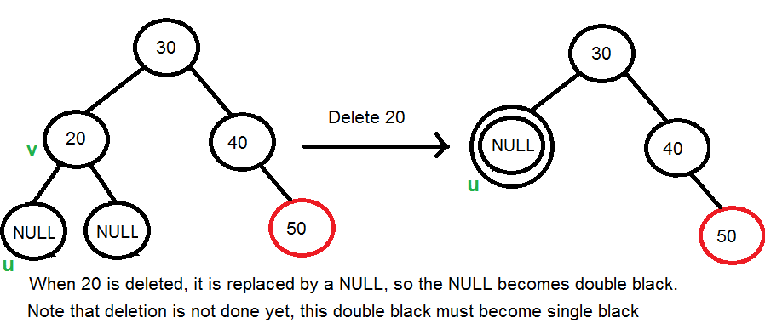
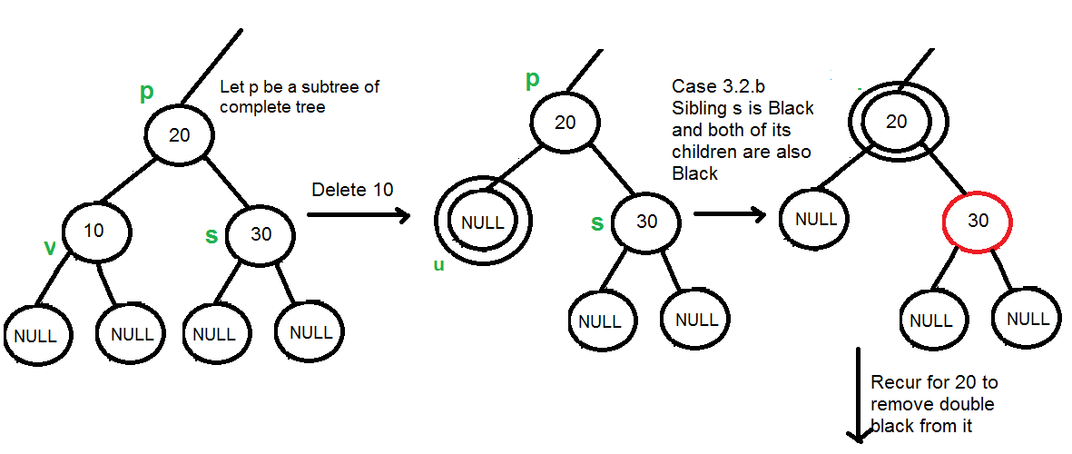
Deletion from a Red Black Tree
3. Both c and x are black nodes.
Colour c as a double black node. If x is a leaf node, then the NULL node is considered to be double black.
If c becomes ROOT after deletion of x, then turn color of c to black irrespective of it’s present color.
Let s be the sibling of c.
If sibling is black; and both it’s children are black, perform recolouring. Recur it for it’s parent, if parent is black too.

Slide 18
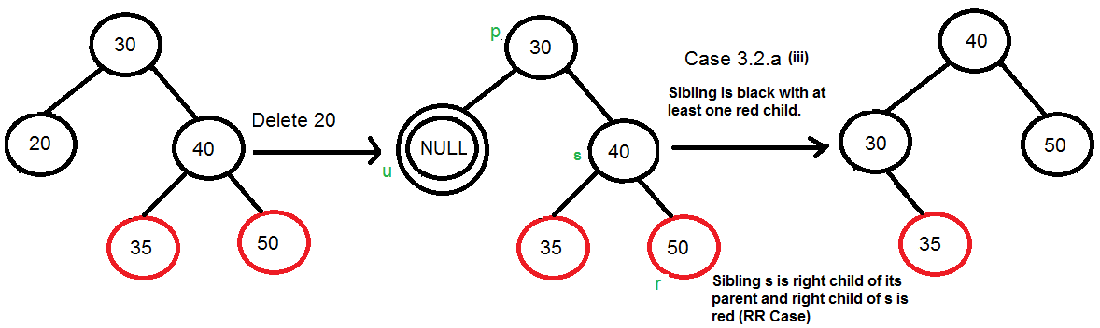
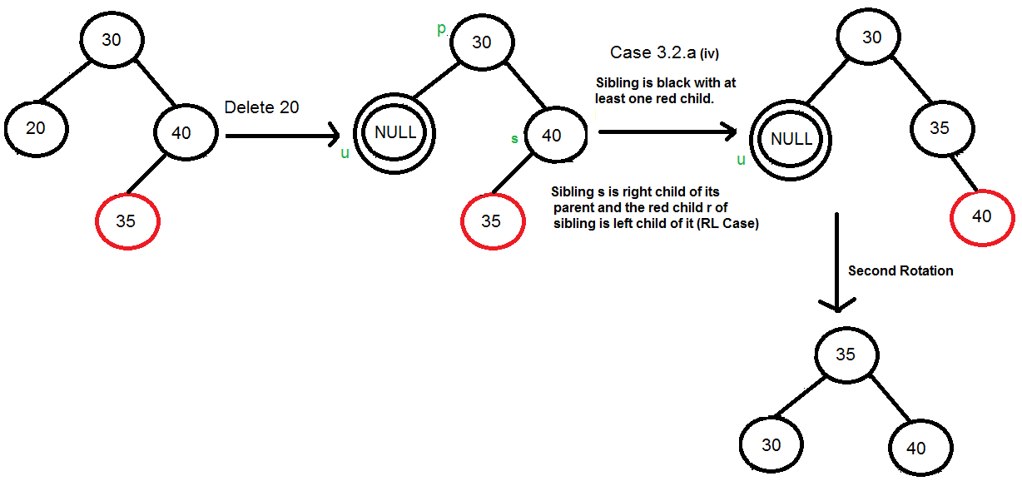
Deletion from a Red Black Tree
b. Perform rotations, if r is the child of s, s is black, and at least one r is red.
Again, rotations can be divided into 4 cases as previously observed.
L-L (Mirror of R-R Case shown)
R-R
L-R (Mirror of R-L Case shown)
R-L
If parent is red, directly make it black; else, recur.

Slide 19
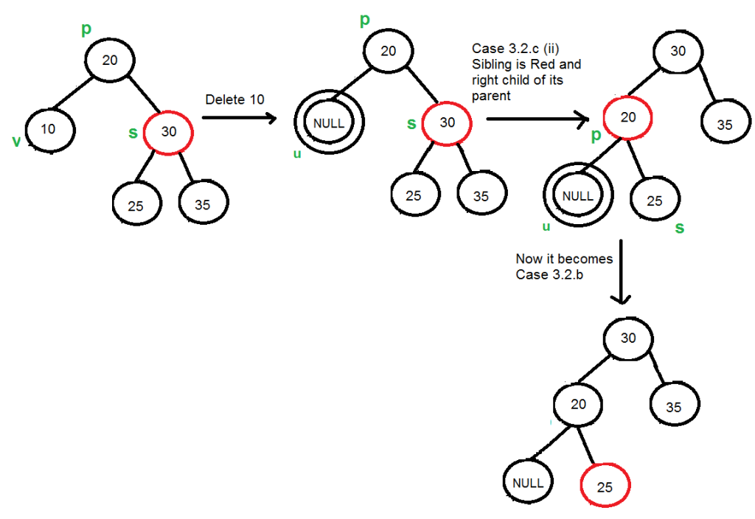
Deletion from a Red Black Tree
c. If s is red, perform a rotation, move the old sibling up, and recolor it and the parent.
New sibling will always be black (rules of RBT).
This, by rotation, converts the tree into a case that can be solved by a. or b.
This can be divided into two simple cases.
Left Case (mirror of the diagram)
Right Case (represented by diagram)

Slide 20

SIMULATION

Slide 21
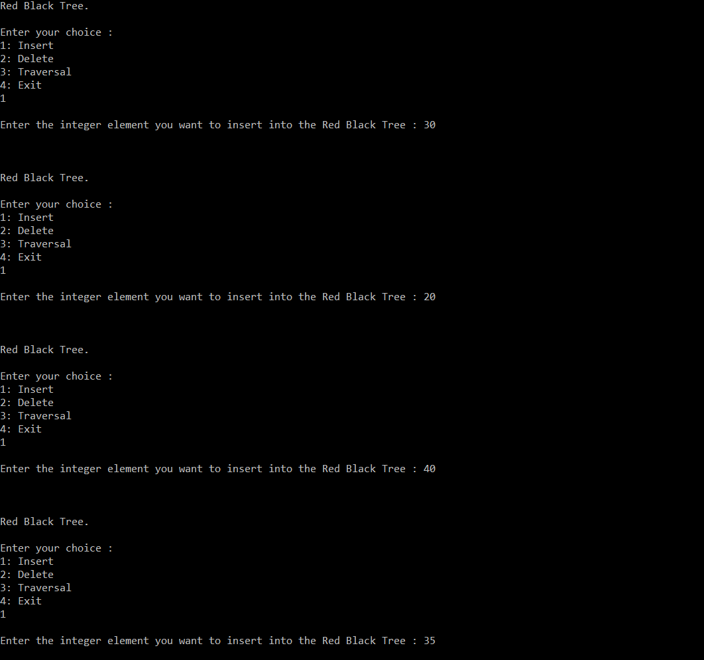
Execution
Snapshots

Slide 22
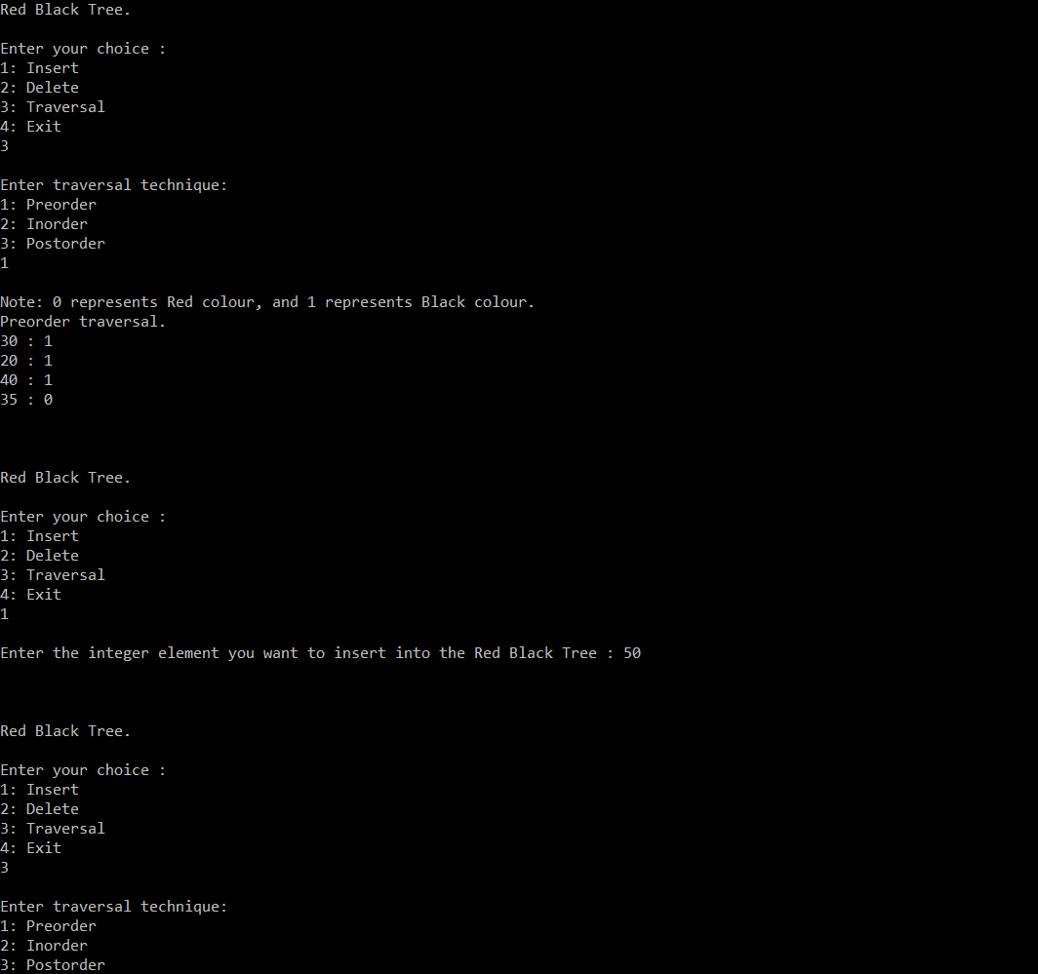
Execution
Snapshots

Slide 23
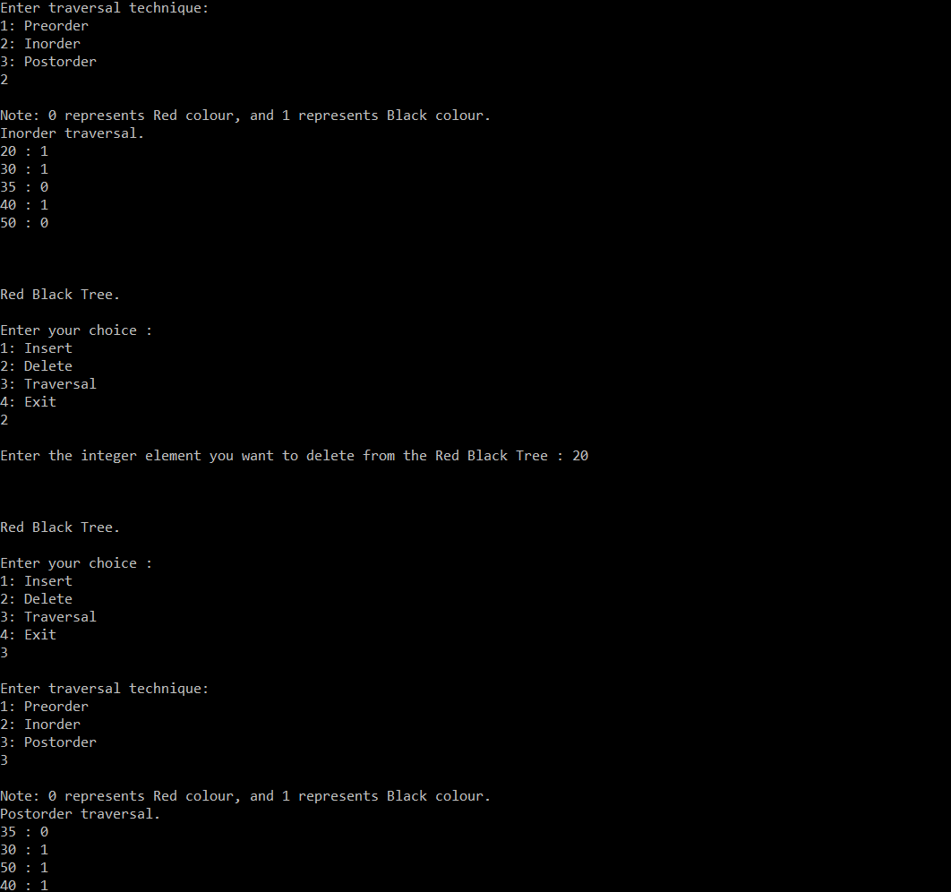
Execution
Snapshots

Slide 24
Real world applications of Red Black Tree
So, we’ve got some Red-Black theory, but where do they find application?
The Linux Kernel:
For example in a process scheduler or for keeping track of the virtual memory segments for a process. Virtual memory can be checked on using the command vmstat.
They are also used in map, multimap, multiset from C++ STL
They are also used in java.util.TreeMap , java.util.TreeSet from Java.
Algorithmic Application:
They are used in K-mean clustering algorithm for reducing time complexity.
MySQL :
MySQL uses Red-Black Trees for managing indexes on tables.

